Slide 1

object-oriented systems in R
Ildi Czeller : @czeildi

Slide 2
- Data Scientist @Emarsys - 3 years R - started with C++, Python
Me:

Slide 3
- R user without CS background - understand core concepts - explore & debug more effectively
You:

Slide 4
summary(lm(y~x))
summary(c(1:99, 10^6))
...
Coefficients:
...
Signif codes: 0 ‘***’
Multiple R-squared: 0.7262
Min. : 1.0
1st Qu.: 25.8
Median : 50.5
Mean : 10049.5
3rd Qu.: 75.2
Max. :1000000.0

Slide 5

object =
behavior
+
data
attend -> learn talk at -> feedback organize -> proud
date: 2018-05-15 venue: Budapest # participants: 450

Slide 6
S3

Slide 7
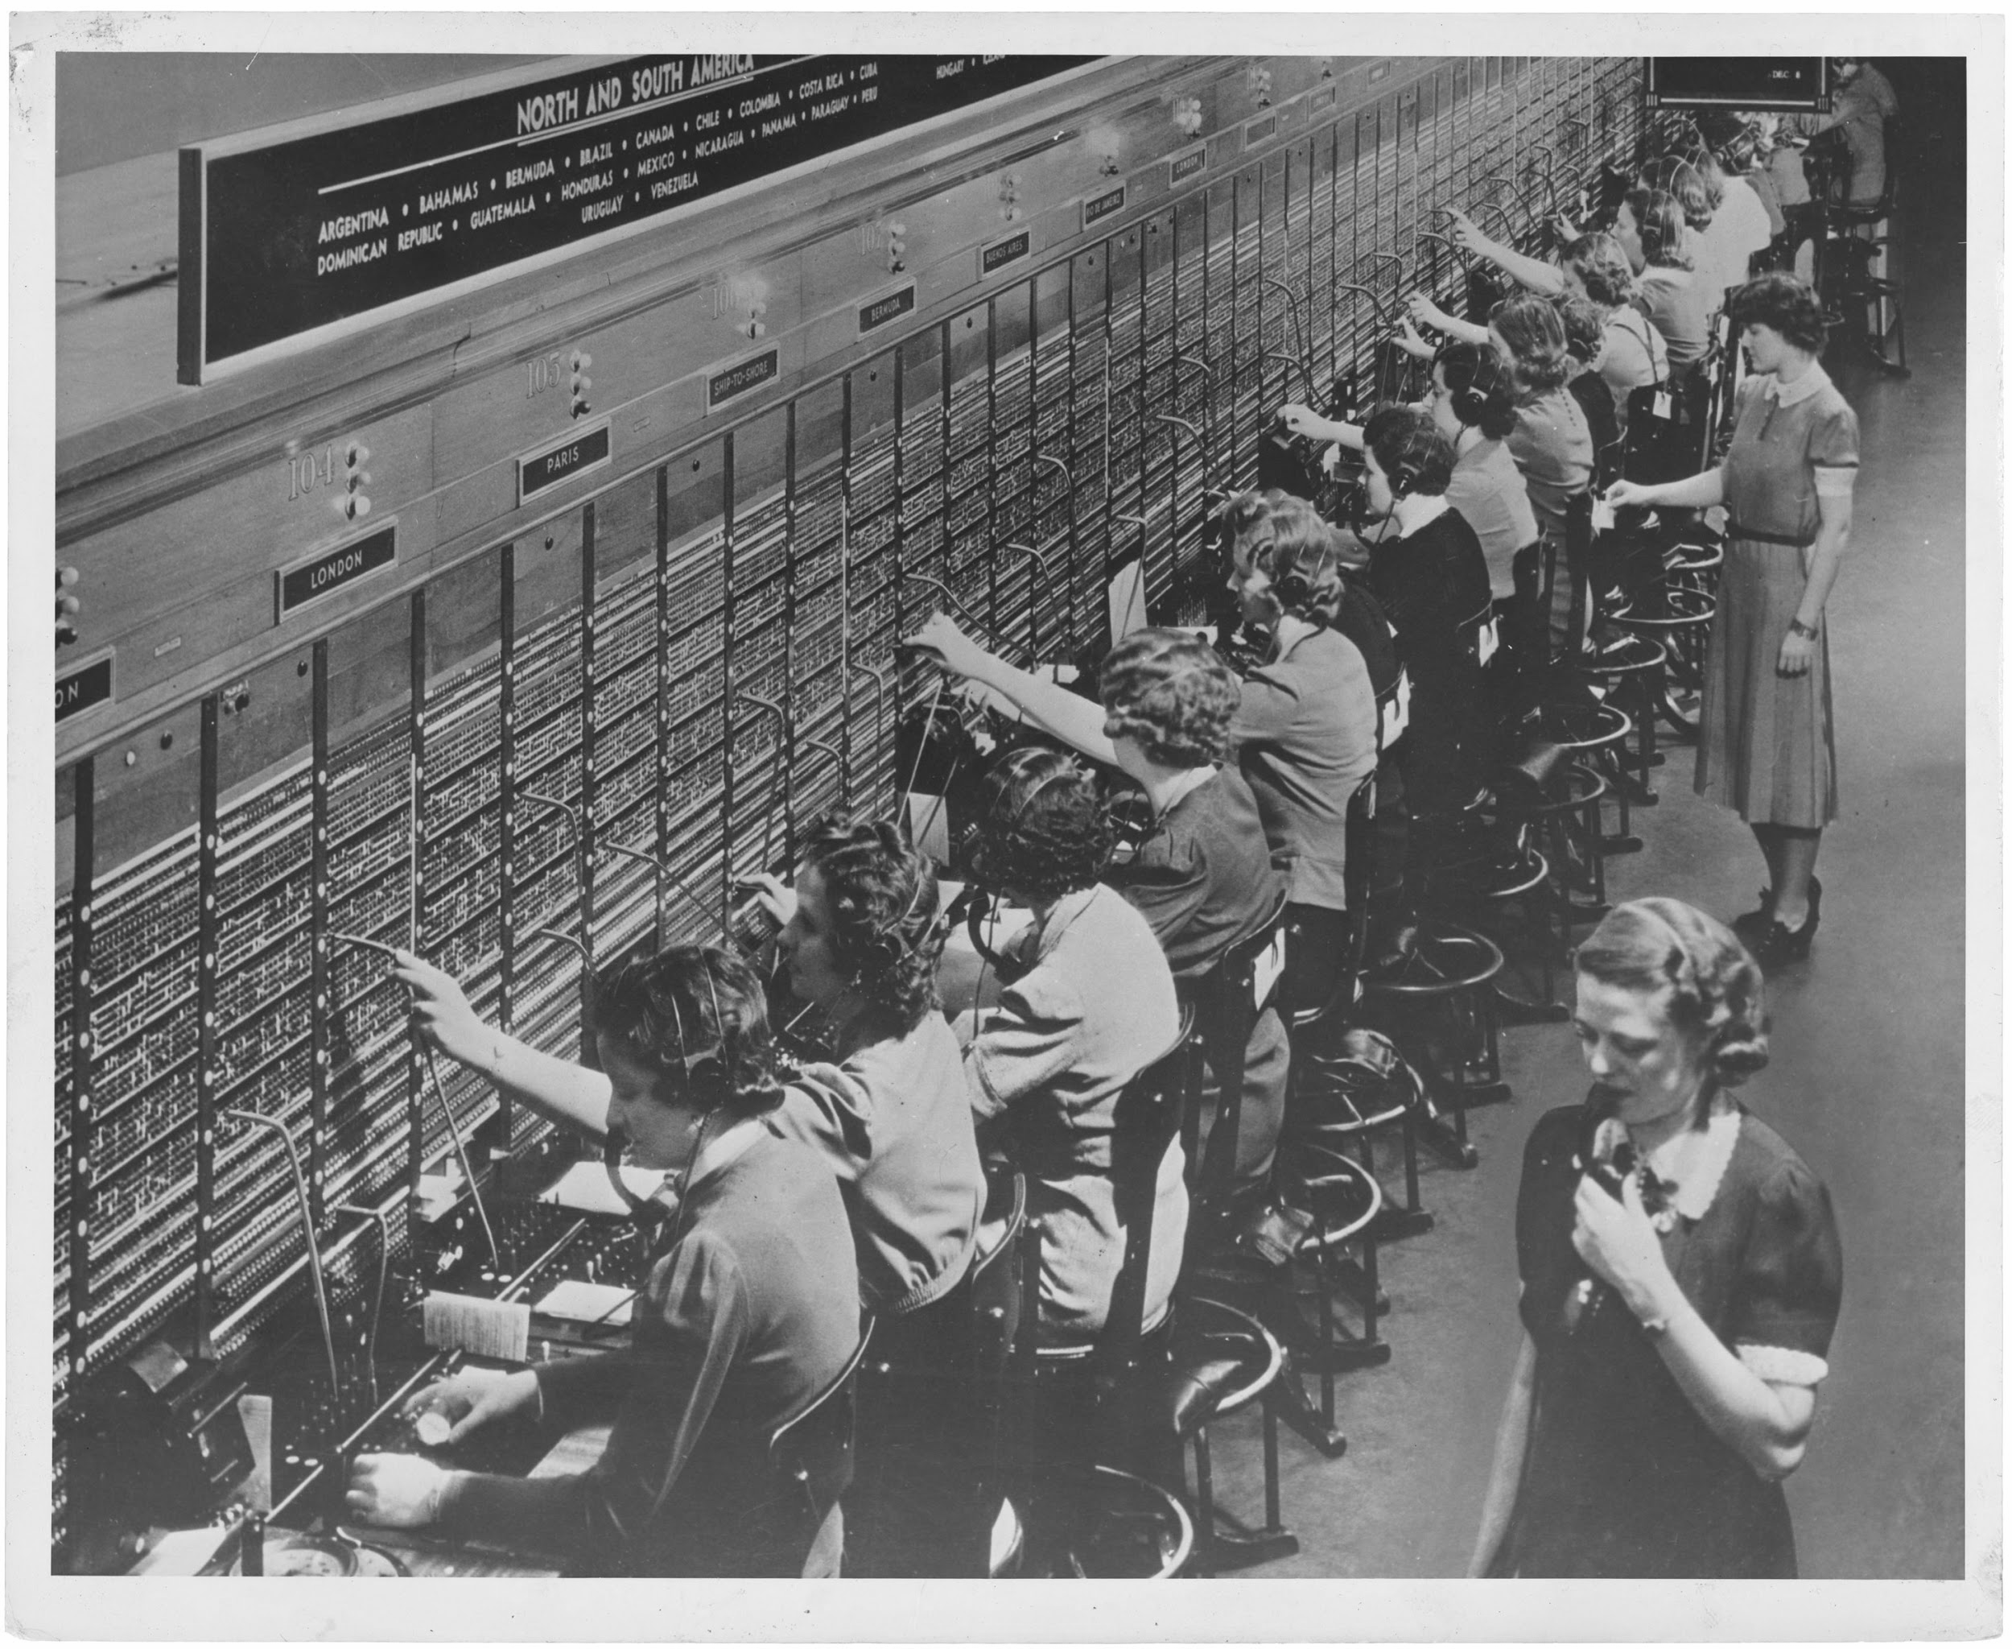
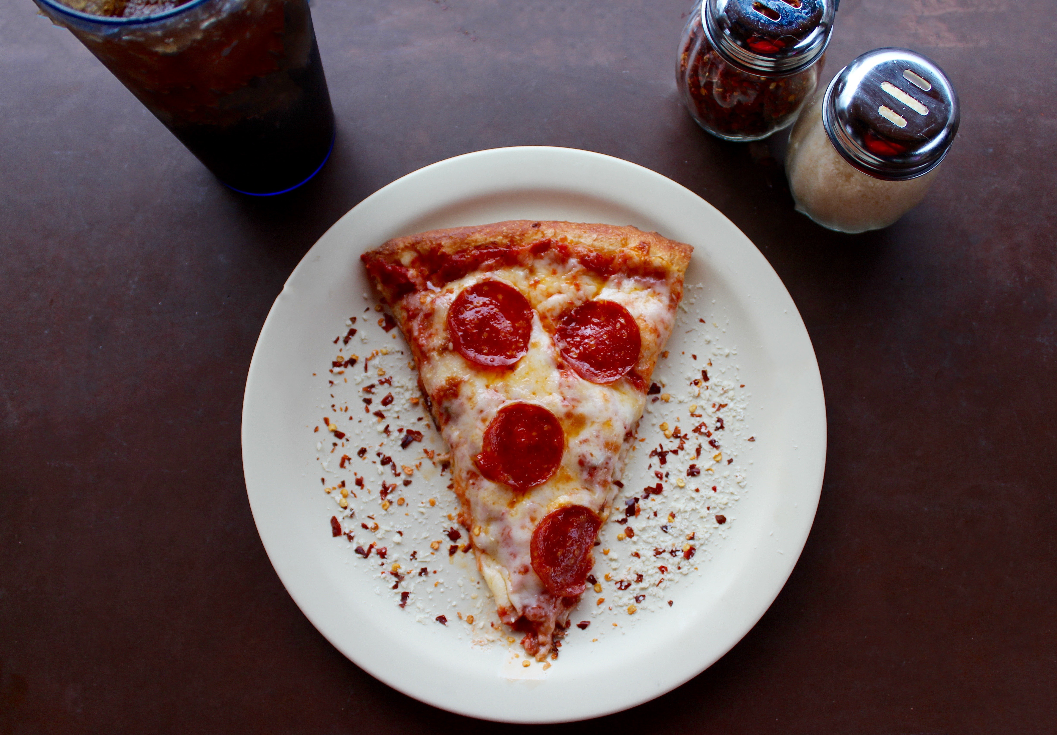

+36 1 333-3333

Slide 8
lm(y~x)
summary.lm
Coef R^2
summary

Slide 9
class + generic
dispatch method
lm(y~x)
+
summary.lm
summary

Slide 10
details

Slide 11


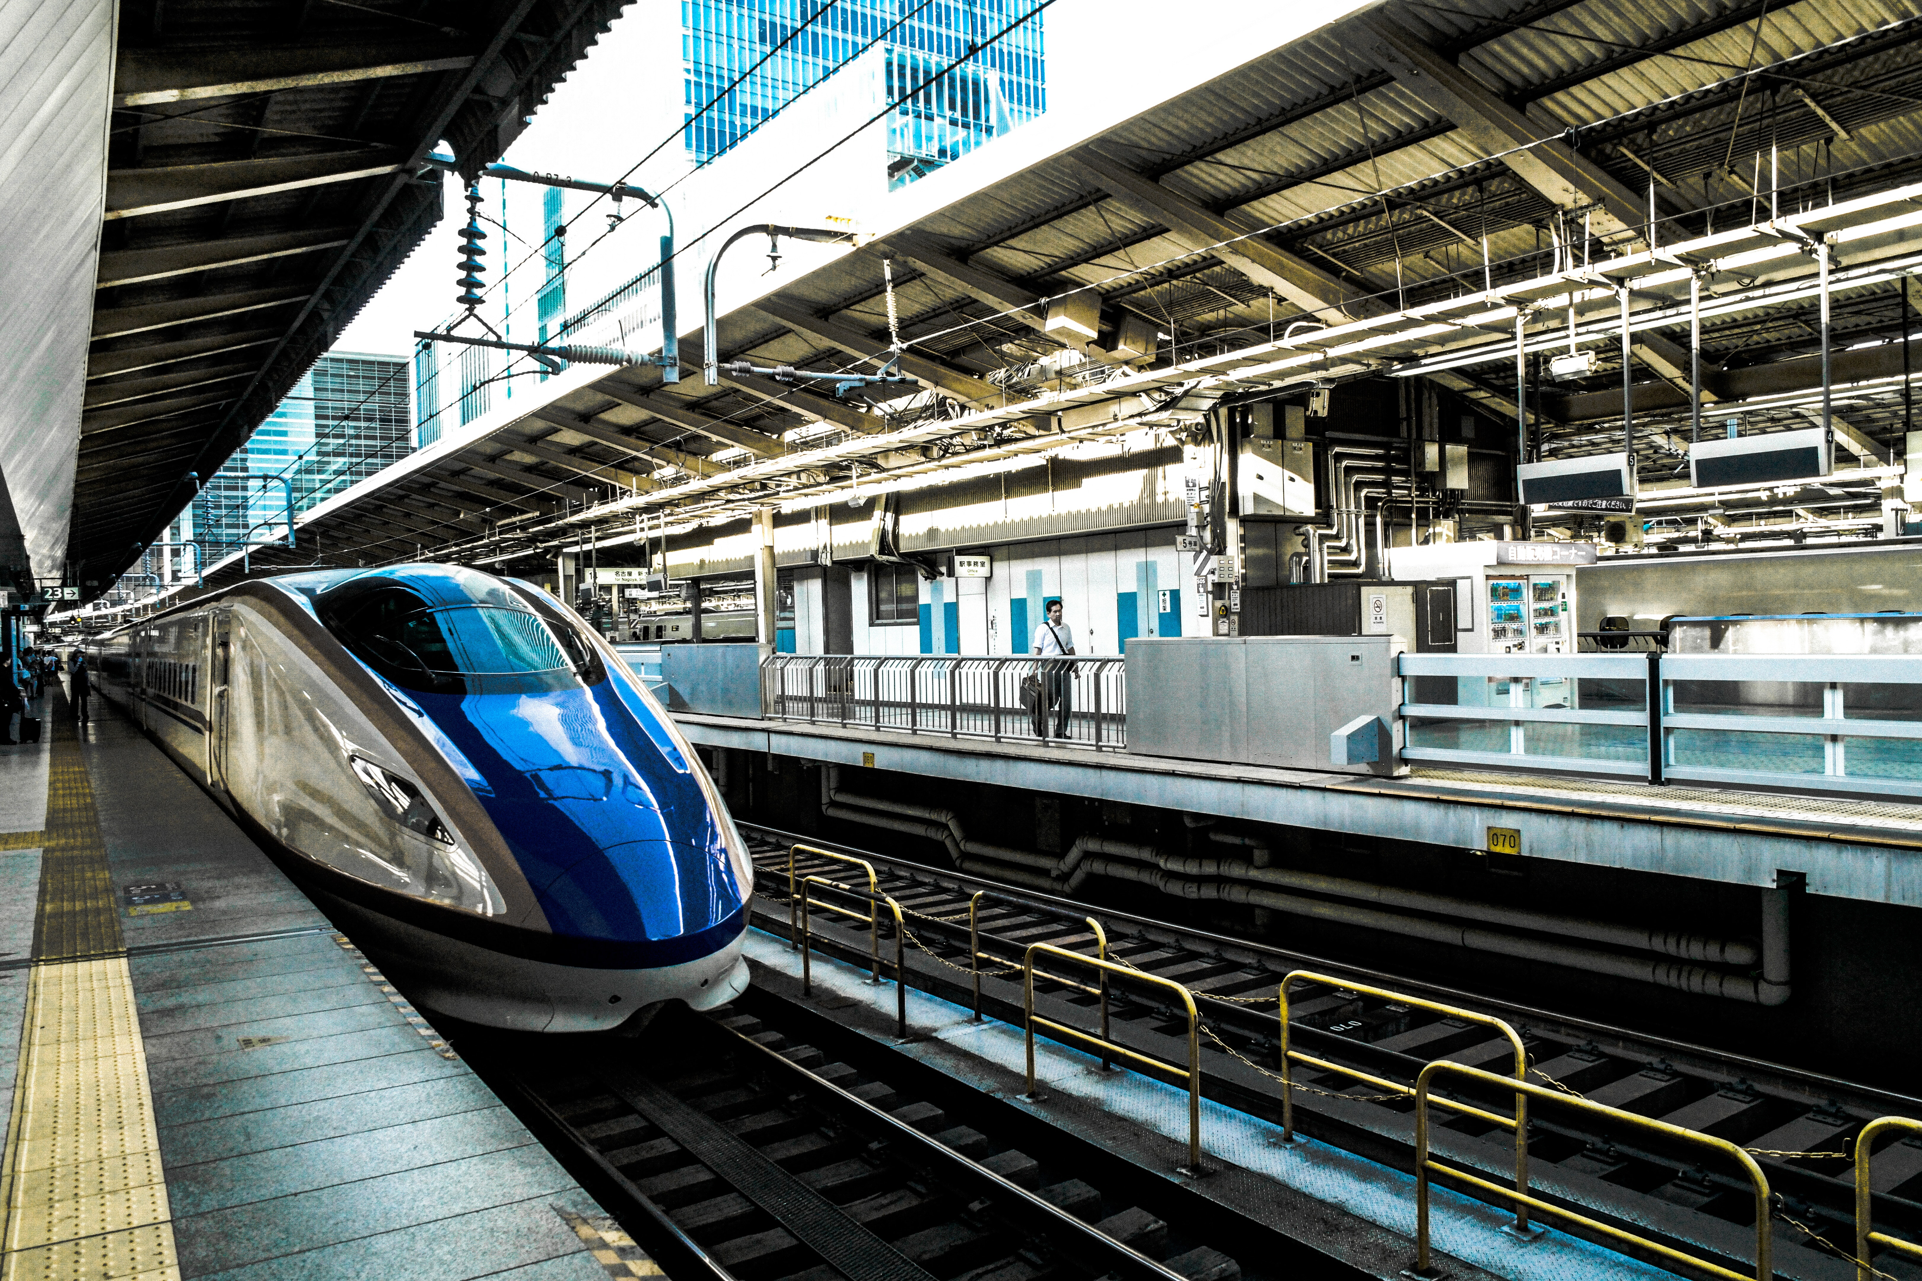
class / object type
Notes:
Data structure + possible behavior. No common structure enforced but good to keep

Slide 12
type/class in R
integer
character
list
Date
data.frame
r_conference
base types
S3 types

Slide 13
method
summary.lm
generic
class
as.factor
Notes:
Implement functionality for specific type

Slide 14
method
summary.data.frame
generic
class
as.Date.numeric
generic
class
Notes:
Implement functionality for specific type

Slide 15
generic
summary <- function(object, …)
UseMethod(“summary”)
sum <- function(…, na.rm = FALSE)
.Primitive(“sum”)

Slide 16
summary(lm(y~x))
dispatch
summary.lm(lm(y~x))
Coefficients: …
Signif codes: 0 ‘***’
Multiple R-squared: 0.7262

Slide 17
why so powerful?

Slide 18
flexible & extensible

Slide 19
base R + different packages work together
Notes:
Methods for generic at different places, methods for class at different places

Slide 20
complex types can inherit behavior from simpler types

Slide 21
class is a vector
c(“r_conference”, “conference”, “event”)
most specific → → → least specific

Slide 22
specialize
print(data.table())
print.data.table(data.table())
Sepal.Length Sepal.Width 1: 5.1 3.5 2: 4.9 3.0 3: 4.7 3.2 4: 4.6 3.1 5: 5.0 3.6 --- 146: 6.7 3.0 147: 6.3 2.5 148: 6.5 3.0 149: 6.2 3.4 150: 5.9 3.0
print(data.frame())
print.data.frame(data.frame())
Sepal.Length Sepal.Width 1 5.1 3.5 2 4.9 3.0 3 4.7 3.2 4 4.6 3.1 5 5.0 3.6 6 5.4 3.9 7 4.6 3.4 8 5.0 3.4 9 4.4 2.9 10 4.9 3.1
…
Notes:
Method might not be exported from package, like print.data.table

Slide 23
fallback
summary(data.table())
summary.data.table(data.table())
summary.data.frame(data.table())
Sepal.Length Min. :4.300 1st Qu.:5.100 Median :5.800 Mean :5.843 3rd Qu.:6.400 Max. :7.900
summary(data.frame())
summary.data.frame(data.frame())
Sepal.Length Min. :4.300 1st Qu.:5.100 Median :5.800 Mean :5.843 3rd Qu.:6.400 Max. :7.900
Notes:
Method might not be exported from package, like print.data.table

Slide 24


extend
gift.conference
gift.r_conference

Slide 25
learn more

Slide 26
explore
seq.Date
data.table:::print.data.table
lookup::lookup(“sum”) – Jim Hester
https://github.com/wch/r-source

Slide 27
explore
sloop – R package by Hadley Wickham
s3_class, ftype
s3_dispatch
s3_methods_class, s3_methods_generic

Slide 28
Advanced R by Hadley Wickham https://www.ildiczeller.com/2018/04/02/investigating-difftime-behavior/

Slide 29
take-away

Slide 30
use understand (create)

